Slide 1
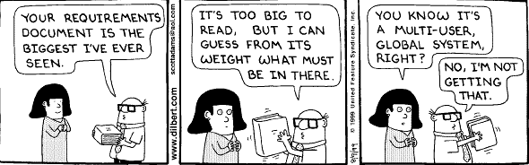
SYSTEM
REQUIREMENTS
SPECIFICATION
Specifying the Specifications

Slide 2
REVIEW FROM LAST CLASS
Requirements Engineering Tasks
Inception
Elicitation
Elaboration - next brief topic
Negotiation
Specification - main topic tonight
Validation
Management

Slide 3
MODELING
What are the benefits of building a model?
So, what needs to be modeled?

Slide 4
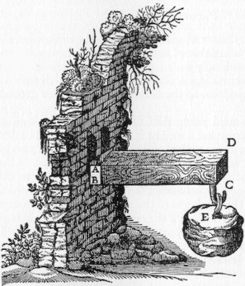
SYSTEM MODELING
Function & Information Flow Model
  what we will do with the data
Data Model
  structure of the information
Behavior Model
  how we interact with the system

Slide 5
FUNCTIONAL AND INFORMATION FLOW MODELING
Data Flow Diagrams
compiler
source
code
characters
machine
instructions
object
code
Syntax
Analysis
Semantic
Analysis
characters
tokens
yadda yadda
machine
instructions
DFDs also require
a Data Dictionary

Slide 6
DATA MODELING
Data Objects, Attributes, Relationships
  Formatted as Lists or Tables
Entity Relationship Diagrams
monitors
security
system
enables/disables
sensor
tests
programs
is programmed by

Slide 7
BEHAVIOR MODELING
State Transition Diagram
start
done
file name
1
2
3
read msg
save msg
send
compose
4

Slide 8
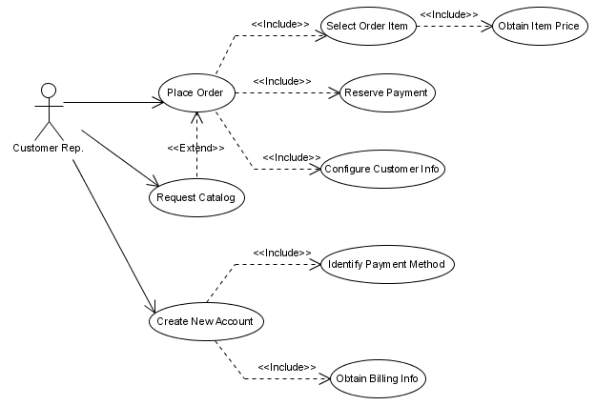
COMBINING INFO FLOW & BEHAVIOR
Use Cases

Slide 9
Requirements Engineering Tasks
Inception
Elicitation
Elaboration
Negotiation
Specification
Validation
Management

Slide 10
TECHNICALLY SPEAKING,
"REQUIREMENT" ≠ "SPECIFICATION"
Requirement – understanding between customer and supplier
Specification – what the software must do
Requirements that are not in the SRS
  Costs
  Delivery dates
  Acceptance procedures
  etc

Slide 11
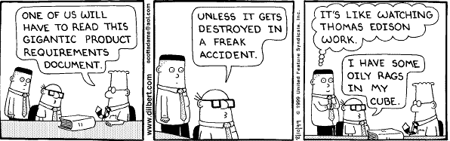
USES OF THE SRS
Design
Validation
Customer Contract – rarely

Slide 12
USES OF THE SRS
Design
Validation
Customer Contract – rarely

Slide 13
DESIRED SRS CHARACTERISTICS
Complete
Consistent
Changeable
Traceable

Slide 14
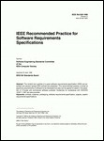
IEEE 830
Characteristics of a Good SRS
Unambiguous
Complete
Verifiable
Consistent
Modifiable
Traceable
Usable during the Operation and Maintenance Phase

Slide 15
IEEE 830
Role of SRS
“The SRS must correctly define all of the software requirements, but no more.”
“The SRS should not describe design, verification, or project management details, except for required design constraints.”

Slide 16
AMBIGUOUSNESS – EXAMPLE ONE
The control total is taken from the last record.
The total is taken from the record at the end of the file.
The total is taken from the latest record.
The total is taken from the previous record.

Slide 17
AMBIGUOUSNESS – EXAMPLE TWO
All customers have the same control field.
All customers have the same value in their control field.
All control fields have the same format.
One control field is issued for all customers.

Slide 18
EXPRESSING REQUIREMENTS
Through input/output specs
  aka IEEE 830 Format
Use of Representative Examples
Specification through Models

Slide 19
SRS TABLE OF CONTENTS
Introduction
  Purpose
  Scope
  Definitions
  References
  Overview
General Description
  Product Perspective
  Product Functions
  User Characteristics
  General Constraints
  Assumptions and Dependencies
Specific Requirements

Slide 20
3. Specific Requirements
3.1 Functional Requirements
3.1.1 Func Req 1
3.1.1.1 Introduction
3.1.1.2 Inputs
3.1.1.3 Processing
3.1.1.4 Outputs
3.1.2 Func Req 2
…
3.2 External Interface Requirements
3.2.1 User Interface
3.2.2 Hardware Interfaces
3.2.3 Software Interfaces
3.2.4 Communication Interfaces
3.3 Performance Requirements
3.4 Design Constraints
3.4.1 Standards Compliance
3.4.2 Hardware Limitations
3.5 Attributes
3.5.1 Security
3.5.2 Maintainability
3.6 Other Requirements
3.6.1 Database

